Slide 1
Legend of Super Spy
Lili Wang

Slide 2
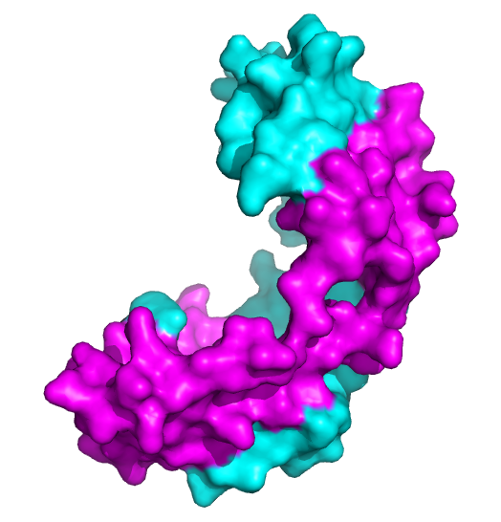
Spy - Spheroplast Protein Y
Forms stable dimer
Induction through Bae and Cpx stress response pathways
unfolded periplasmic proteins
tannin
ethanol, butanol
Makes up to 50% of total periplasm when induced
ATP-independent folding chaperone
A client protein: Im7L53AI54A (unfolded)
PDB: 3O39

Slide 3
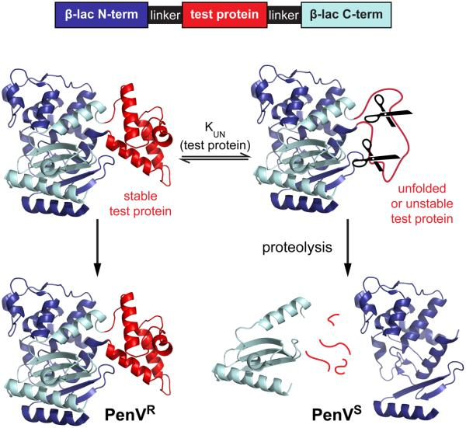
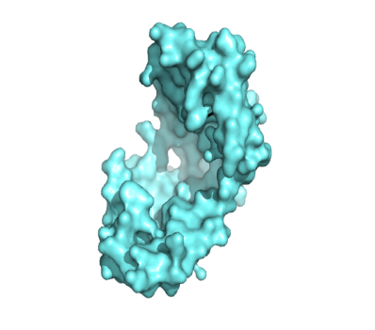

Screen for Spy mutants: better “folder” of Im7L53AI54A
Im7L53AI54A
WT Spy
Unfolded or unstable Im7L53AI54A
Mutated Spy
Pen V 3000/4000 ug/ml, 0.1mM IPTG
Random mutagenesis library of Spy
Better stabilize Im7L53AI54A → More b-Lac →Higher PenV resistance
Notes:
Use error-prone PCR to make a random mutagenesis library of Spy
Select for the mutants with a higher efficiency to stabilize Im7L53AI54A

Slide 4

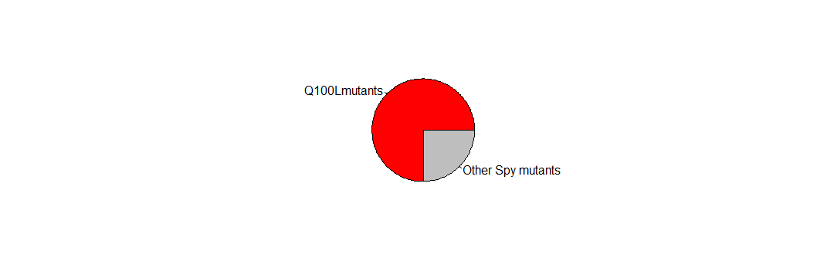
Selected Spy mutations
65 colonies: 64 had mutation (s) in Spy
70% contain the Q100L mutation
Single mutation: Q100L, Q25R, L32P, F115I
Occurred at least 3 times: F115L, Q49L, H96L
Notes:
They’re independently selected and red labeled are found as single mutants
We sequenced 65 colonies and only one of them have no mutation
Change the way to present

Slide 5
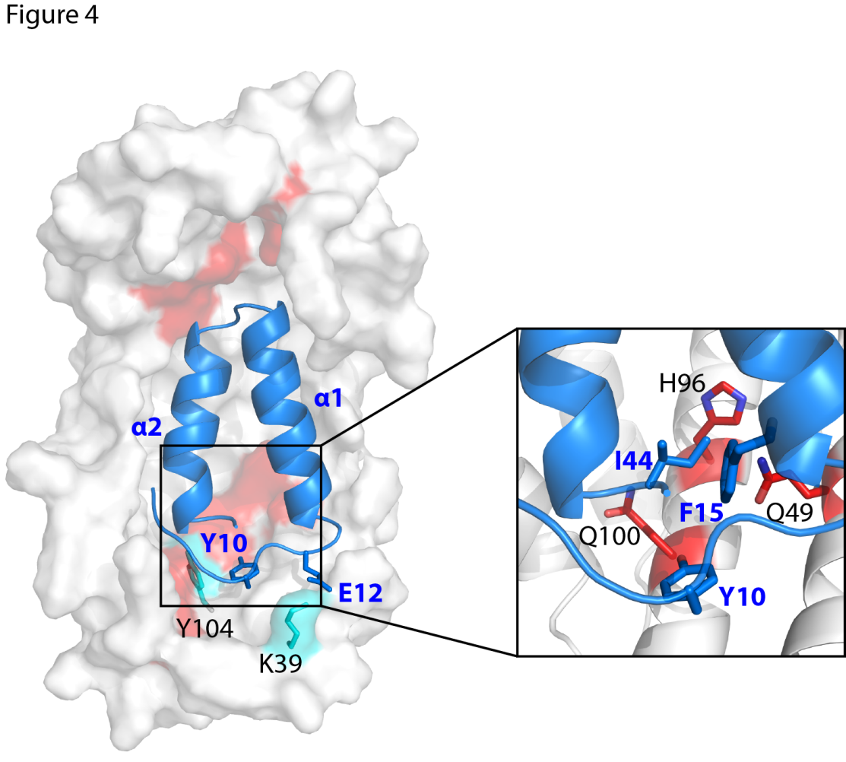
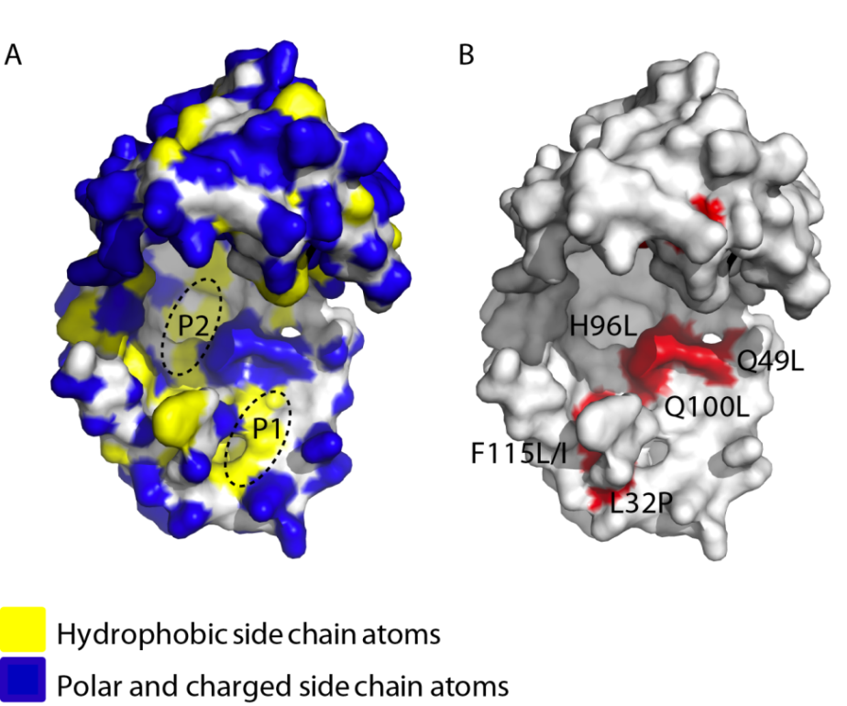
Increased hydrophobicity
Model of Spy and Im7L53AI54A
From Shu

Slide 6
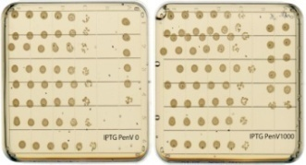
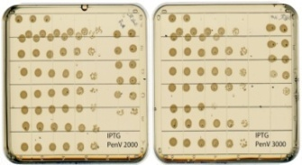
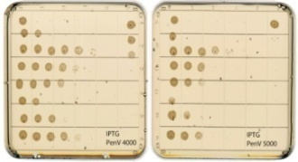
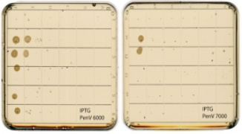
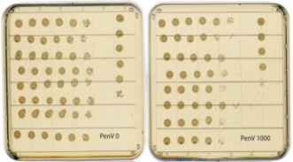
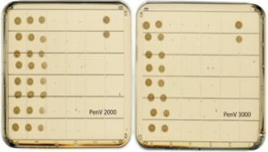
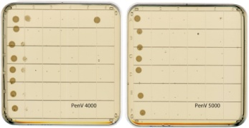
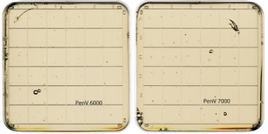
Remade Spy mutants show higher PenV resistance
Highly resistant: Q100L, L32P, F115I/L,H96L
Moderately resistant: Q25R
Less resistant: Q49L
Spy expressed
No Spy express

Slide 7

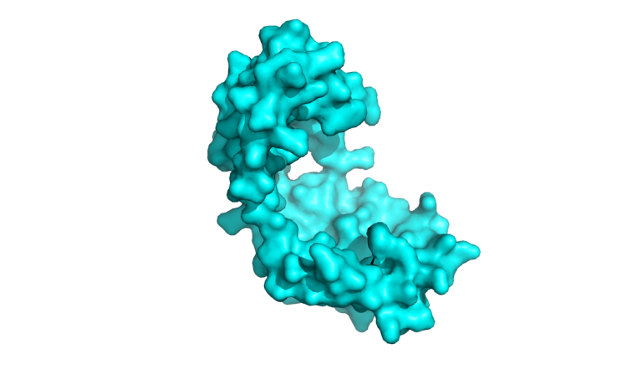
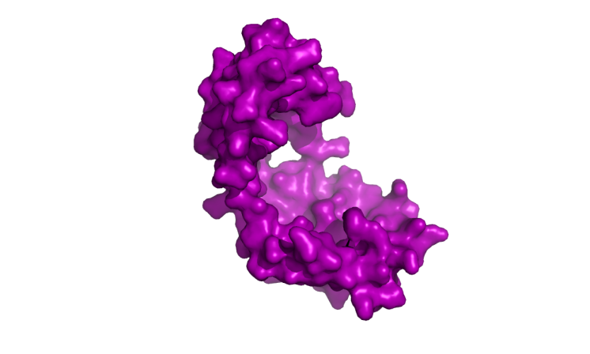
The PenV resistance was expected to correlate with the protein level of β-lactamase-Im7AA fusion
WT Spy
Mutant Spy
Lower Resistance to PenV
Higher Resistance to PenV
Notes:
Change the spelling change all the expression to fusion protein level

Slide 8
The PenV resistance correlates with the protein level of β-lactamase-Im7AA fusion

Slide 9




Quantify the protein level of Spy
β-lactamase
PenV resistance
1
2
Enhanced chaperone activity
More Spy available

Slide 10
The Super Spy variants are not overexpressed

Slide 11
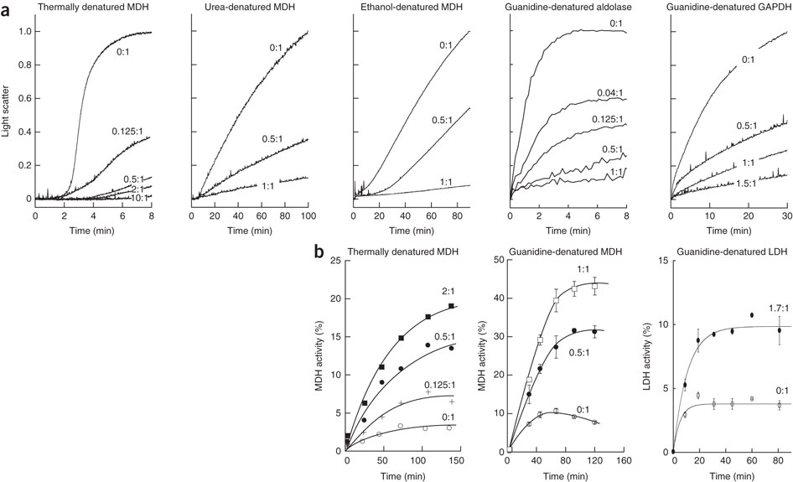
These Super Spy have enhanced chaperone activity?
β-lactamase
PenV resistance
Aggregation
Enhanced chaperone activity
Activity

Slide 12
Substrates list
α-lactalbumin: aggregation induced by the disruption of disulfide bonds after adding DTT→ measure the absorbance under 360nm, 25◦C
Aldolase: aggregation under guanidine and refolding under the protection of Spy at 25◦C

Slide 13
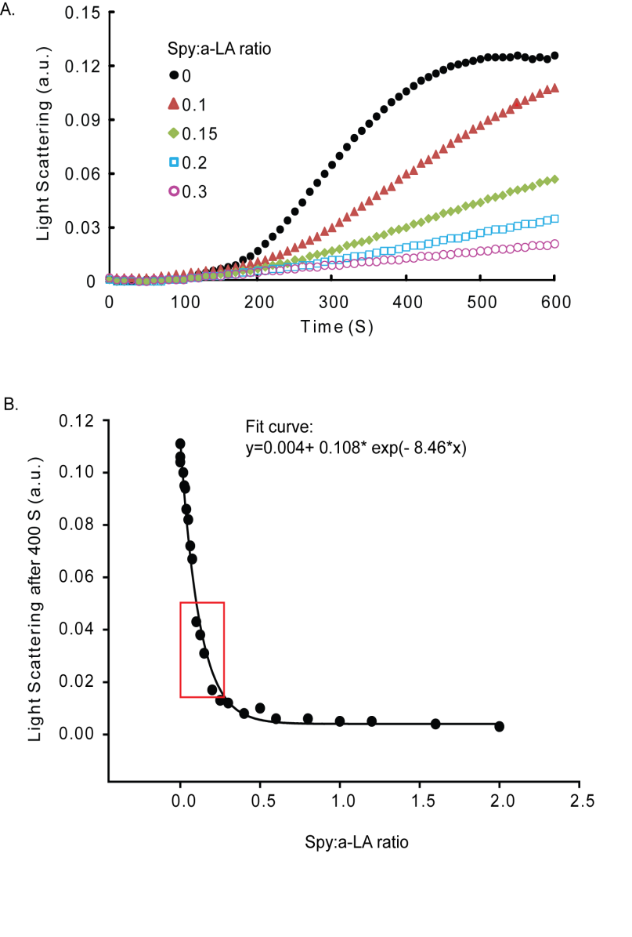
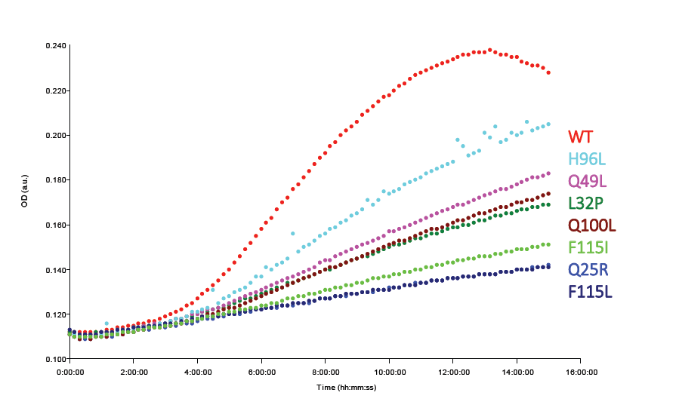
α-lactalbumin aggregation assay
50 µM, 20 mM DTT, 25◦C, 360nm
Light scattering endpoints at 300, 400, 500, and 600 seconds were obtained from the aggregation curves
From Shu

Slide 14
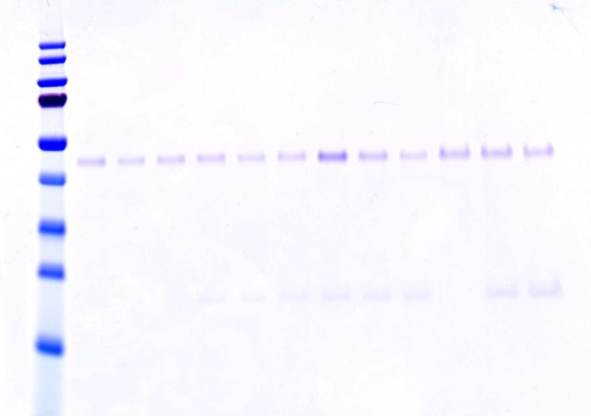
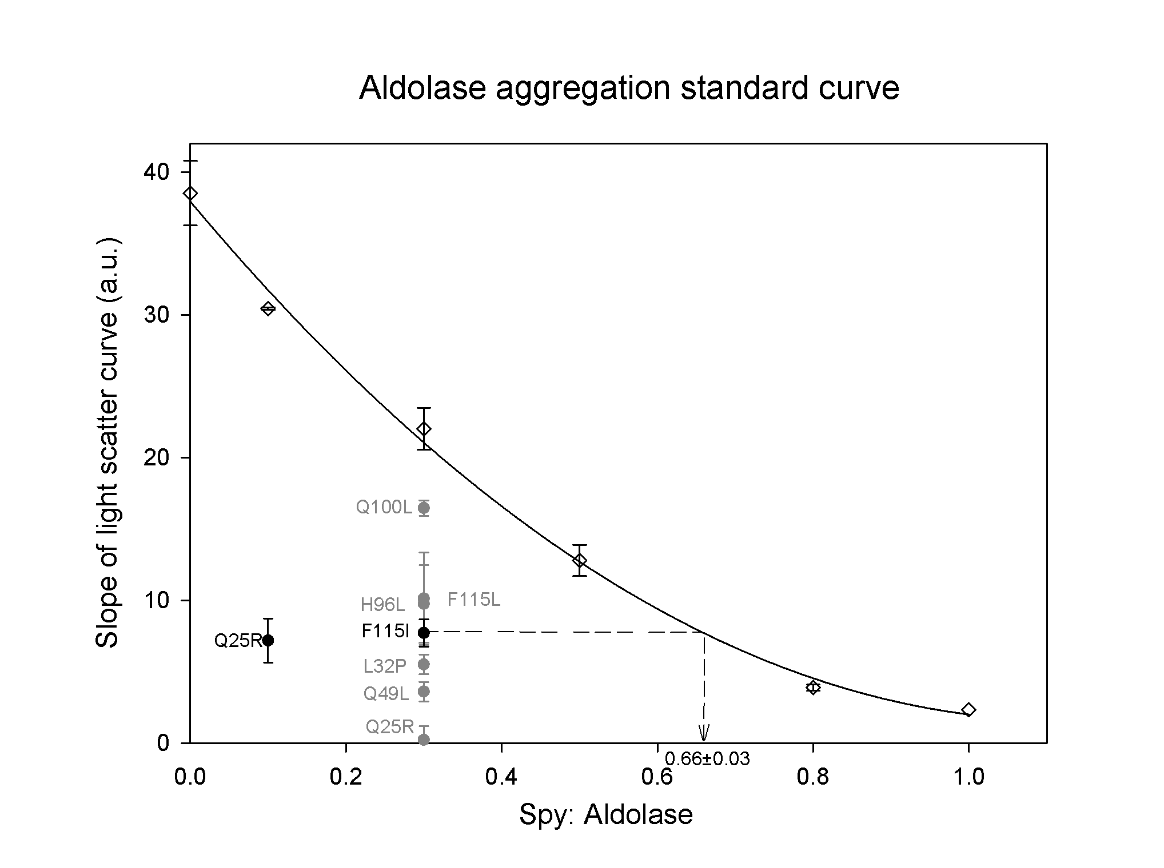
Aldolase aggregation assay
No Spy
Q25RSpy
WT Spy
0.5uM Aldolase, HN7.5 buffer
340nm, 23◦C
Aldolase
Spy

Slide 15
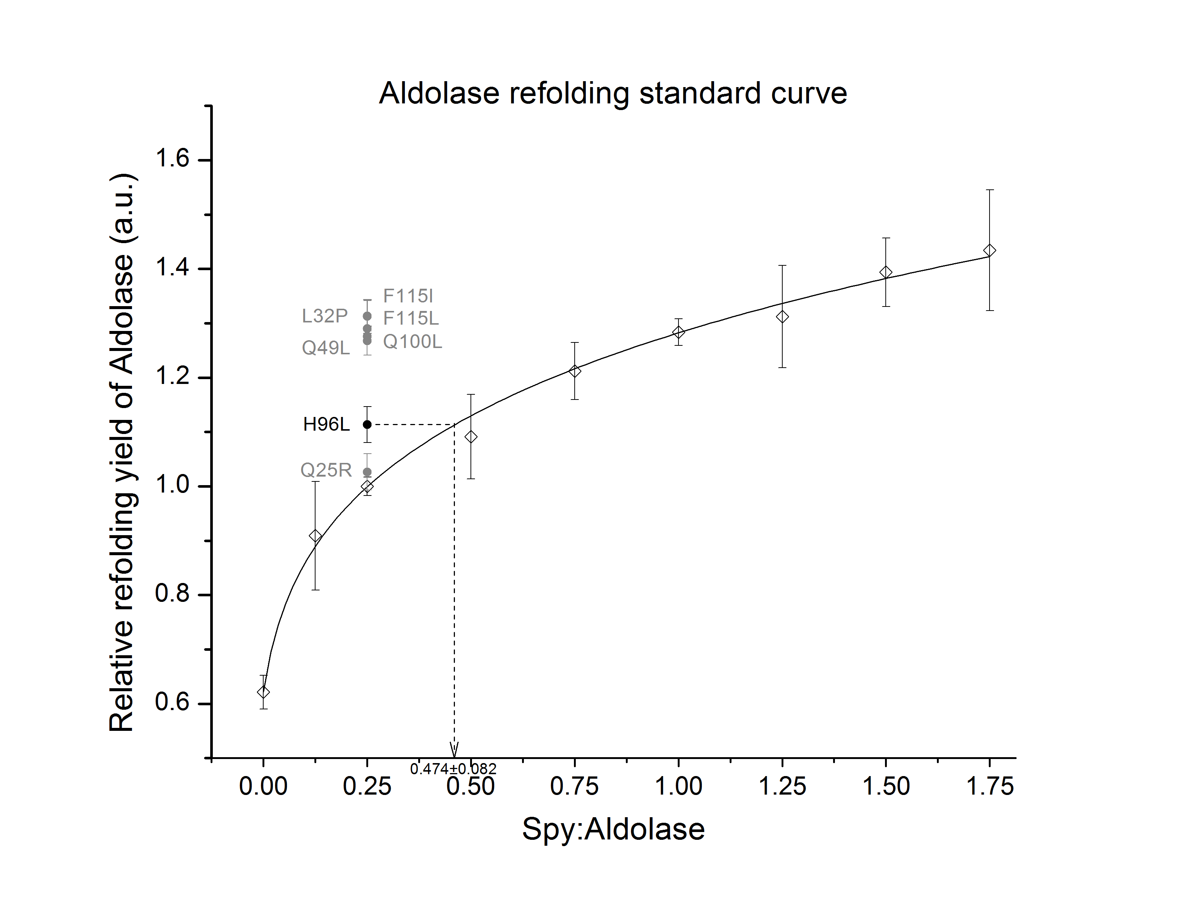
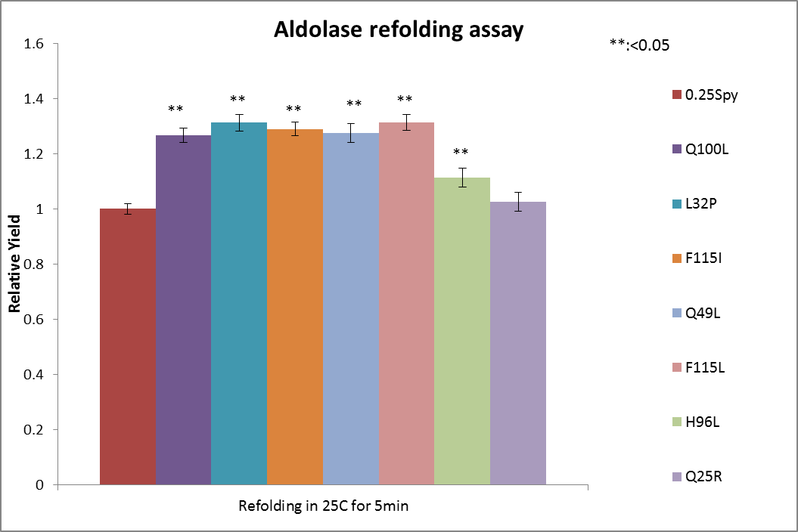
Aldolase refolding assay
25◦C, 250nM refolding, 1 Aldolase: 0.25 Spy
Fructose 1,6-disphosphate + H₂O
Aldolase
G 3-P + DHAP
G 3-P
TPI
DHAP
2 DHAP + 2 NADH
a-GDH
2 a-glycerophosphate + 2 NAD⁺

Slide 16
Super Spy variants have increased in vitro chaperone activity
Spyvariants | Activity (aldolase agg. prev) | Activity (aldolase refold) | Activity (α-LA agg. prev)
WT | 1 | 1 | 1
Q25R | 6.90±0.64 | 1.38±0.31 | 2.44±0.89
L32P | 2.52±0.11 | 4.85±0.57 | 2.1±0.74
Q49L | 2.88±0.14 | 4.25±0.66 | 1.93±0.66
H96L | 2.02±0.32 | 1.90±0.32 | 1.64±0.49
Q100L | 1.34±0.04 | 4.20±0.44 | 2.12±0.75
F115L | 1.98±0.32 | 4.85±0.56 | 2.3±0.83
F115I | 2.21±0.12 | 4.33±0.49 | 2.34±0.85

Slide 17
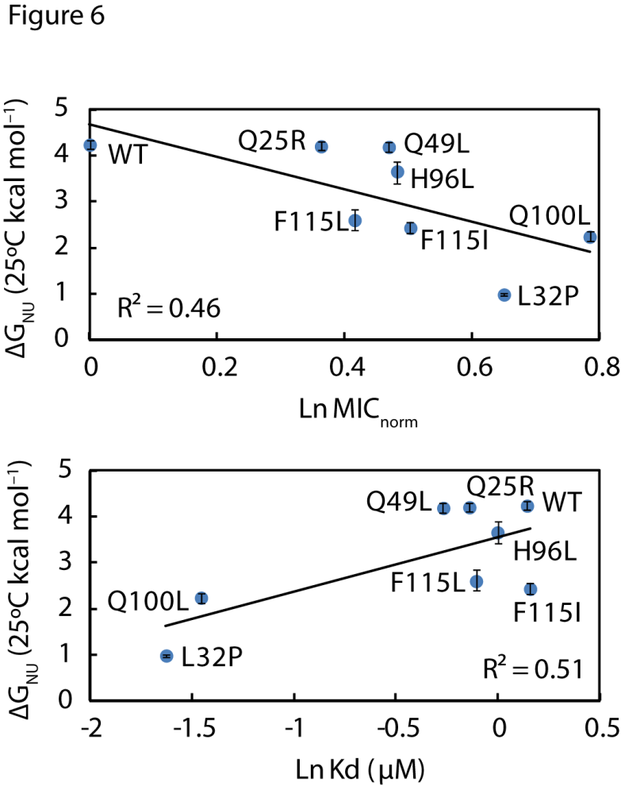
Increased flexibility
Increased hydrophobicity
From Shu

Slide 18
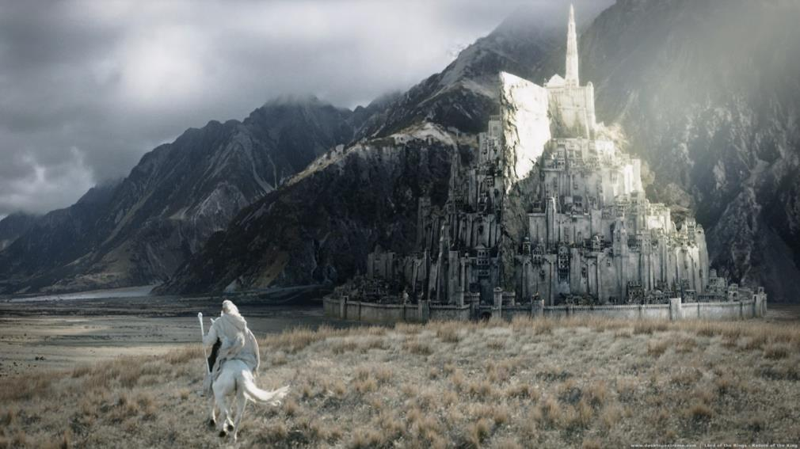
What’s unsolved on Spy?
Can these selected mutations collaborate (synergistic effect)?
Q100L is quite abundant, but why doesn’t it mutate to other aa?
The in vivo substrates of Spy?
Co- structure between Spy and its substrates?
Notes:
What are the scientific questions remain elusive?
Can these mutation effects be additive? (Are there synergistic effects of these mutations?)
Q100L is the dominant mutation, but it only mutate from Q to L in the selection. What can this residue do if mutating to other amino acid residue.
What are the in vivo substrates that Spy protects from tannin stress?
Co- structure between Spy and its substrates? (提这个设想的时候，注意别让Scott误解，你要抢他的课题哦～，要强调一下，除了现在的办法，有没有其它的途径去回答这个问题)

Slide 19
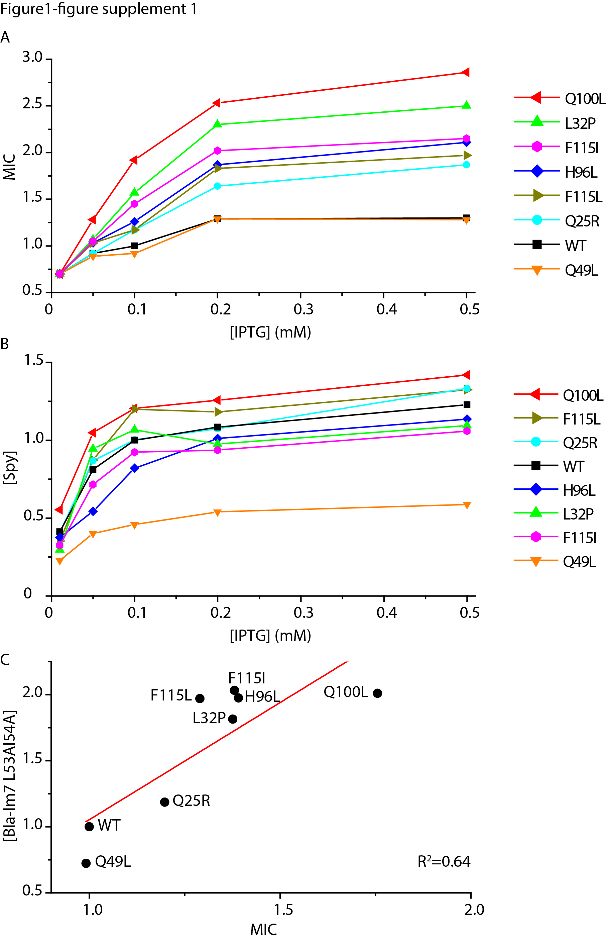

Q100L is a very interesting Super Spy
1. High resistance to PenV
3. Dominant in the selection
4. In crease the hydrophobicity
2. Insignificant difference in expression
Notes:
Q100L is very important position
Q100L is the dominant mutant from the selection.

Slide 20
Q100L is a very interesting Super Spy
5. Strong increase in Chaperone activity:
α-lactalbumin aggregation assay 2.12±0.75
Aldolase aggregation assay 1.34±0.04
Aldolase refolding assay 4.20±0.44
6. Decrease in Kd (dissociation, uM)
WT:1.15±0.027
Q100L: 0.23±0.013 (5 fold decrease)
7. The decrease in Kd is due to the dramatic decrease in Koff (slower release)
 | WT | Q100L
K_{on} (×10⁵ mol⁻¹ s⁻¹) | 3.98±0.11 | 1.19±0.13 (x3)
K_{off} (s⁻¹) | 0.46±0.011 | 0.03±0.002 (x15)
Q100L Spy is much stickier than WT Spy
Notes:
Data from the paper
Cp=dQ/dT
T=dQ/dS

Slide 21
Q100L is a very interesting Super Spy
8. Q100L has the similar melting temperature (Tm:°C) as WT
WT: 48.1±0.1 Q100L: 53.8±0.6
9. Q100L is more flexible than WT
∆G_{NU}(25°C) (kcal mol⁻¹)
WT: 4.24±0.10 Q100L: 2.24±0.11
Notes:
Flexibility: Gnu; deuterium exchange analysis

Slide 22
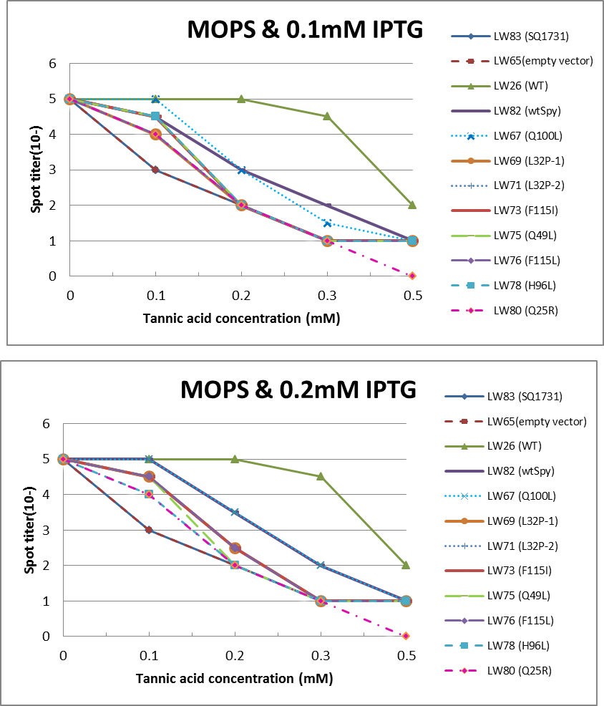
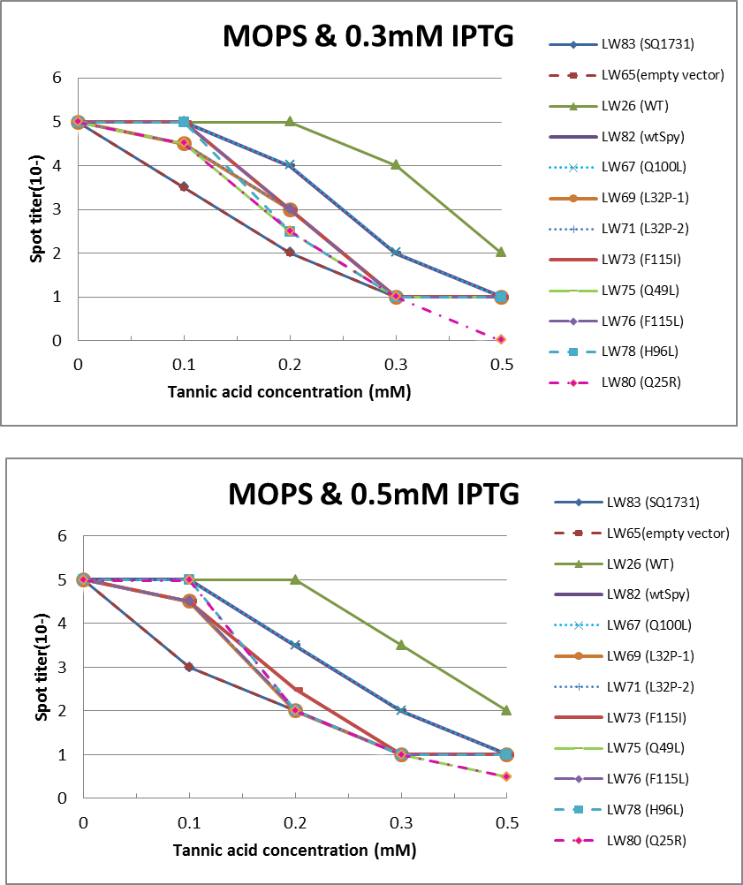
Q100L is a very interesting Super Spy
10. Same tannin resistance for Q100L: trivial change in its activity on the native substrates (green: genome Spy; others: plasmid)
It would be worthy to do it on genome!
Notes:
It will be interesting to look at the genome mutants
Q100L retains the tannin resistance as WT Spy, suggesting the natural substrates of Spy can be well folded by Q100L mutant but not other mutants.

Slide 23
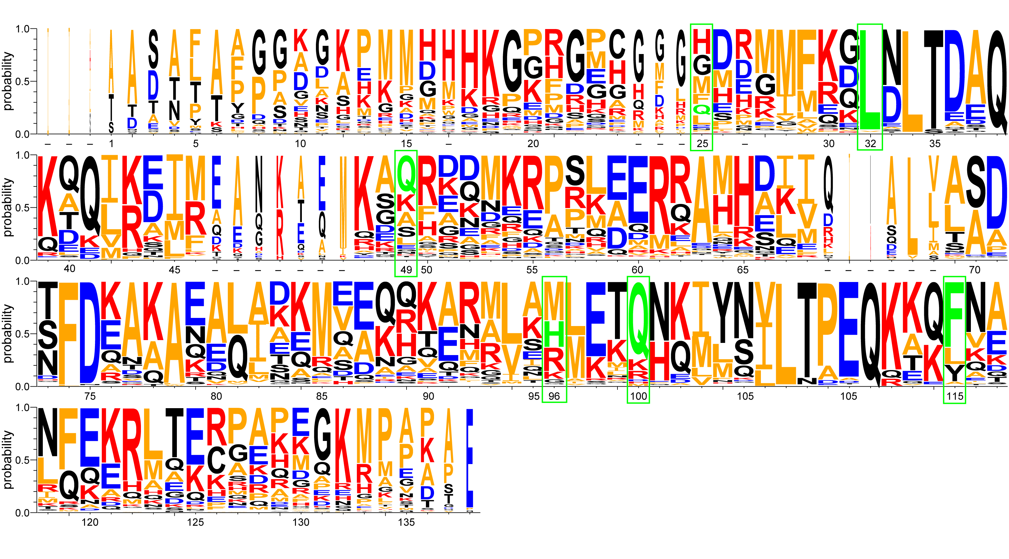
Q100L is a very interesting Super Spy
11. Q100 is mildly conserved: Q, K,R,D,H,M
sequence alignment of 29 Spy orthologous sequences
Done by Shu
Notes:
This picture Ican probably re do
These residues are conserved to some degree, but several residues are variable in the process of evolution
The point
WebLogo representation of a ClustalW sequence alignment of 29 Spy orthologous sequences. Residues are numbered according to the mature protein region of E. coli Spy. Short dashes indicate residues that are absent from E. coli Spy but are present in other aligned sequences. Red: basic residues K, R, and H; blue: acidic residues D and E; orange: hydrophobic residues including A, V, L, I, F, W, M, and P; black: polar uncharged residues including G, S, T, C, Y, N, and Q. Green boxes indicate the location of our Spy mutations with the original residues shownin green. of the logo indicates that Q100 is only mildly conserved. Other amino acid residues do appear.

Slide 24
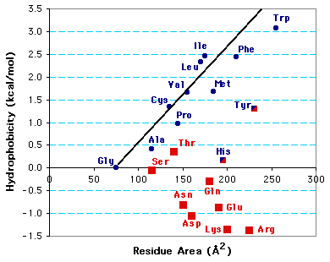
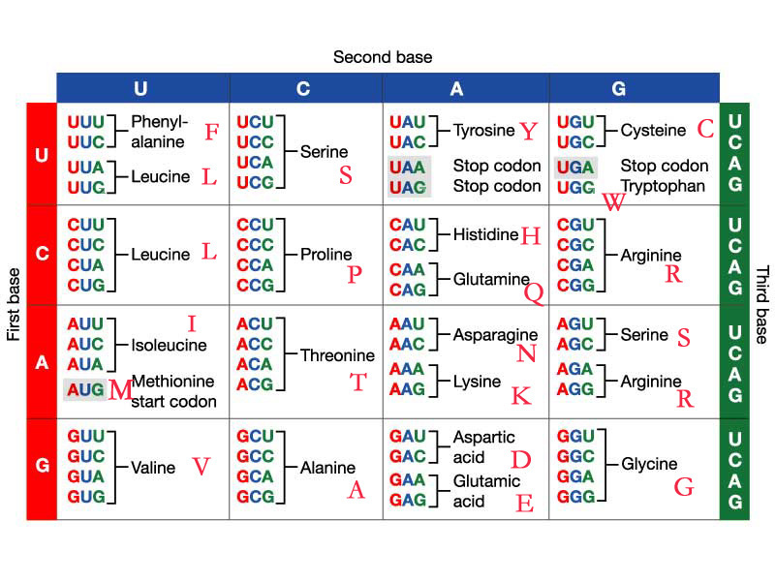
Only Q100L is present in the screen
Codon limitation: only Q100L was found in the screen
One base mutation Q→H, K, E, L, P, R, Stop
Hydrophobic candidates:
Leu (L)
Ile (I)
Phe(F)
Met (M)
Trp (W)
Val (V)
Tyr (Y)
Pro (P) ---structural disruption
Ala (A)
Gly (G)
Notes:
Put the codon onto here Q, K,R,D,H,M happened in native
Why Q100L is so dominant
Other hydrophobic residues as candidates
Please highlight the Q and L from the list. Q to L actually increases the hydrophobicity a lot. Obviously this change is correlated in vivo and in vitro chaperone activity suggesting the direct contact between this residue to substrates. Thus it will be interesting to explore the effects of other possible residues.
Then add a slice to predict what you will see once you make those mutants.
In vivo phenotype will be tested first for : Tannin resistance PenV resistance crosslink assay Example
Mutants (+++ general chaperone) ++ +++ - Q100L
Mutants (only better for Im7) +/- ++ ? N.A.
Mutants (partially lose the chaperone activity) - - +/? Q100 F,Y? Either slow binding or release substrates
Mutants (lose chaperone activity) - - - Q100 E,D?
Unexpected features ? ? ? ??

Slide 25
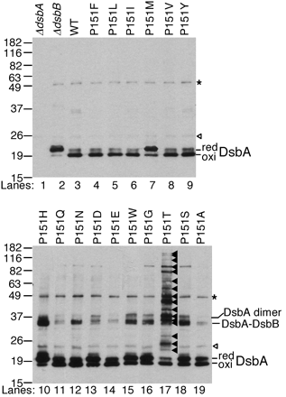
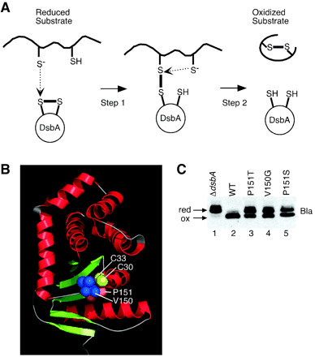
Snapshots of DsbA in Action
Mutation on a very conserved cis-proline: P151T
Too fast
Slow down the release
Kadokura H, Science. 2004
Kadokura H, J Bacteriol. 2005
Notes:
Add a slide, another similar work has been done, check these refs.1) Snapshots of DsbA in action: detection of proteins in the process of oxidative folding.
http://www.sciencemag.org/content/303/5657/534.long

Slide 26
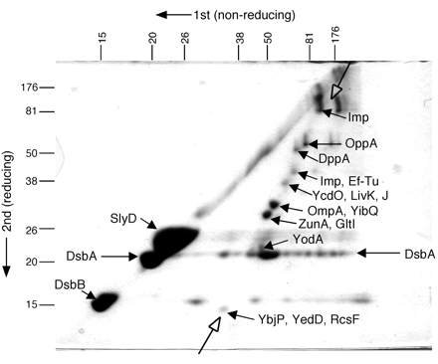
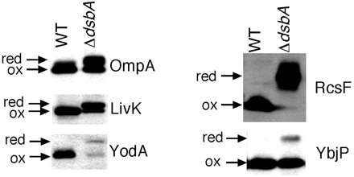
Snapshots of DsbA in Action
Trapped substrates
Kadokura H, Science. 2004
Kadokura H, J Bacteriol. 2005
Notes:
2) Mutational Alterations of the Key cis Proline Residue That Cause Accumulation of Enzymatic Reaction Intermediates of DsbA, a Member of the Thioredoxin Superfamily

Slide 27
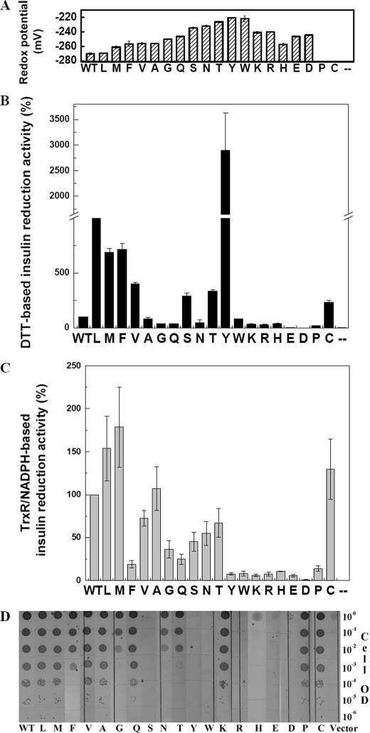
Modulation on Thioredoxin by single residue substitution
The importance of certain residue I75 outside the thioredoxin characteristic CXXC active site can make a big difference on its activity
Theoredoxin activity assays
copper sensitivity
Hydrophobic
Polar or charged
Ren G, J Biol Chem, 2009
Notes:
Ren’s result
copper sensitivity isomerase test: actually for reductase

Slide 28
Amino acid substitution of Q100
Hydrophobic substitutions at Q100
L, I, F, M, W, V, Y, P, A,G
Polar substitutions at Q100
S, T, C, N
In vivo:
PenV resistance (Im7AA)
Tannin resistance (Native substrates)
In vitro:
Chaperone activity
Kd with Im7AA
Flexibility
Charged substitutions at Q100
D, E, K, R, H
Notes:
Put the codon onto here Q, K,R,D,H,M happened in native
Why Q100L is so dominant
Other hydrophobic residues as candidates
Please highlight the Q and L from the list. Q to L actually increases the hydrophobicity a lot. Obviously this change is correlated in vivo and in vitro chaperone activity suggesting the direct contact between this residue to substrates. Thus it will be interesting to explore the effects of other possible residues.
Then add a slice to predict what you will see once you make those mutants.
In vivo phenotype will be tested first for : Tannin resistance PenV resistance crosslink assay Example
Mutants (+++ general chaperone) ++ +++ - Q100L
Mutants (only better for Im7) +/- ++ ? N.A.
Mutants (partially lose the chaperone activity) - - +/? Q100 F,Y? Either slow binding or release substrates
Mutants (lose chaperone activity) - - - Q100 E,D?
Unexpected features ? ? ? ??

Slide 29
Predicted results
WT
PenV resistance: ++
Tannin resistance:++
Chaperone activity:++
Kd: ++
Flexibility:++
Increase the hydrophobicity by introducing in hydrophobic residues will increase the activity of Spy→ Super-sticky Spy
PenV resistance:+++
Tannin resistance:+++
Chaperone activity:+++
Koff and Kd w/ Im7AA: + (stickier)
Flexibility: +++
P disrupts Spy structure and function
M is present in evolution
Hydrophobic substitutions at Q100
L, I, F, M, W, V, Y, P, A,G
Polar substitutions at Q100
S, T, C, N
PenV resistance: ++
Tannin resistance:++
Chaperone activity:++
Kd w/ Im7AA: ++
Flexibility: ++
Codon limitation: not present in evolution
PenV resistance: +
Tannin resistance: +
Chaperone activity:+
Kd with Im7AA: +++
Flexibility: +
Lose Spy function? No necessary
K, R, D, H have been present in evolution
Charged substitutions at Q100
D, E, K, R, H
? Hard to predict
Notes:
N: asparagine
Q:glutamine
D: aspartic acid (2C)
E: glutamatic acid (3C)
K: Lysine

Slide 30
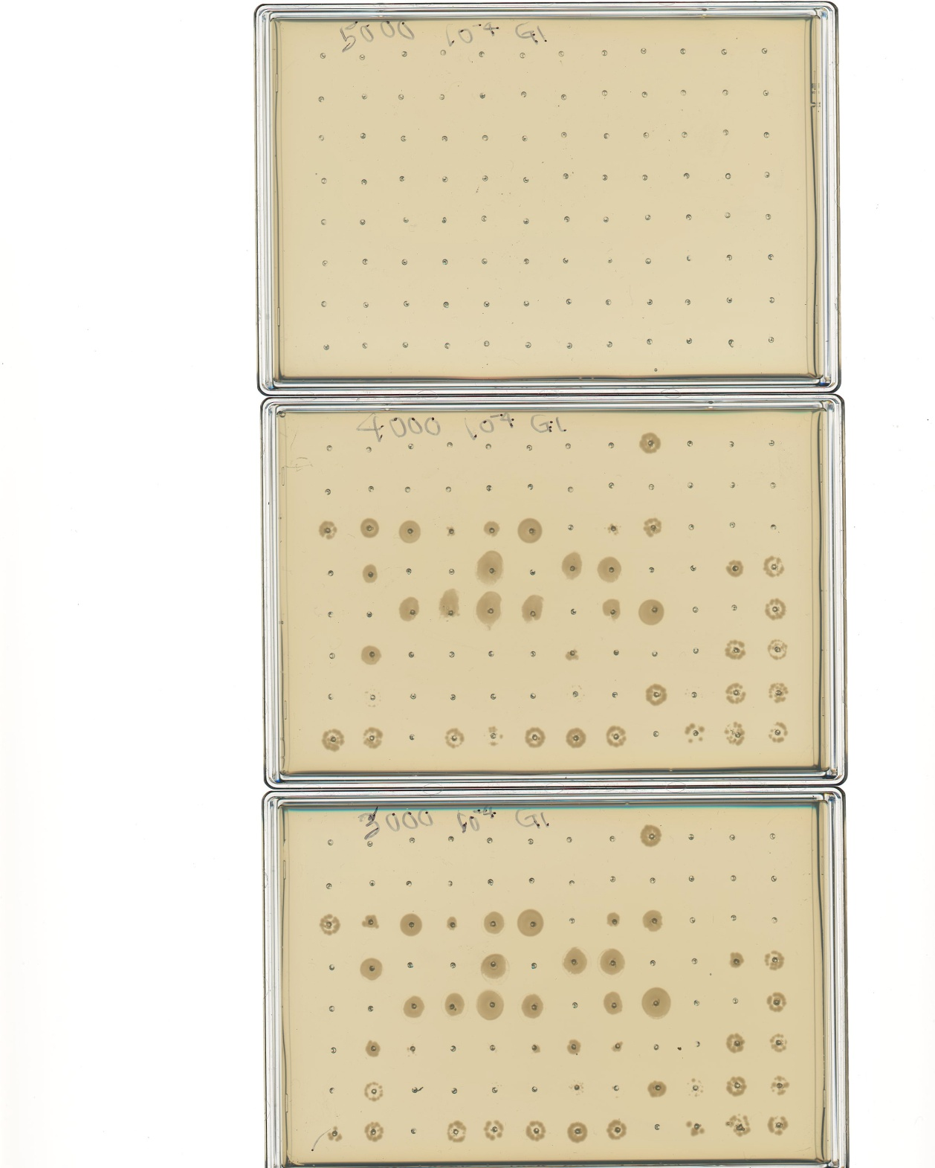
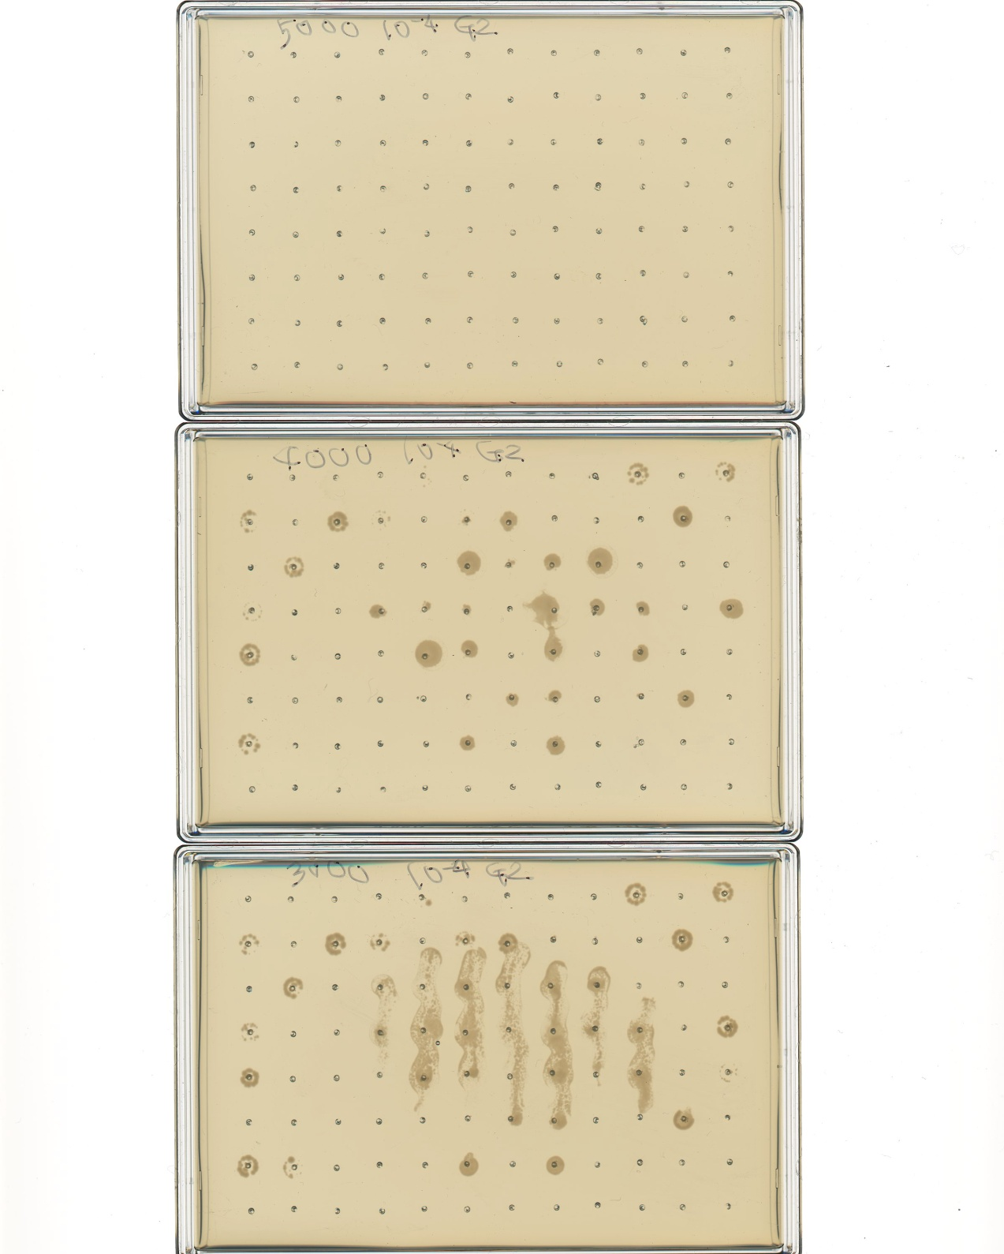
Selected candidates
Notes:
Need to make it clear why show this figure? Because you want to check if there are combinatory effects to those positive mutations?

Slide 31
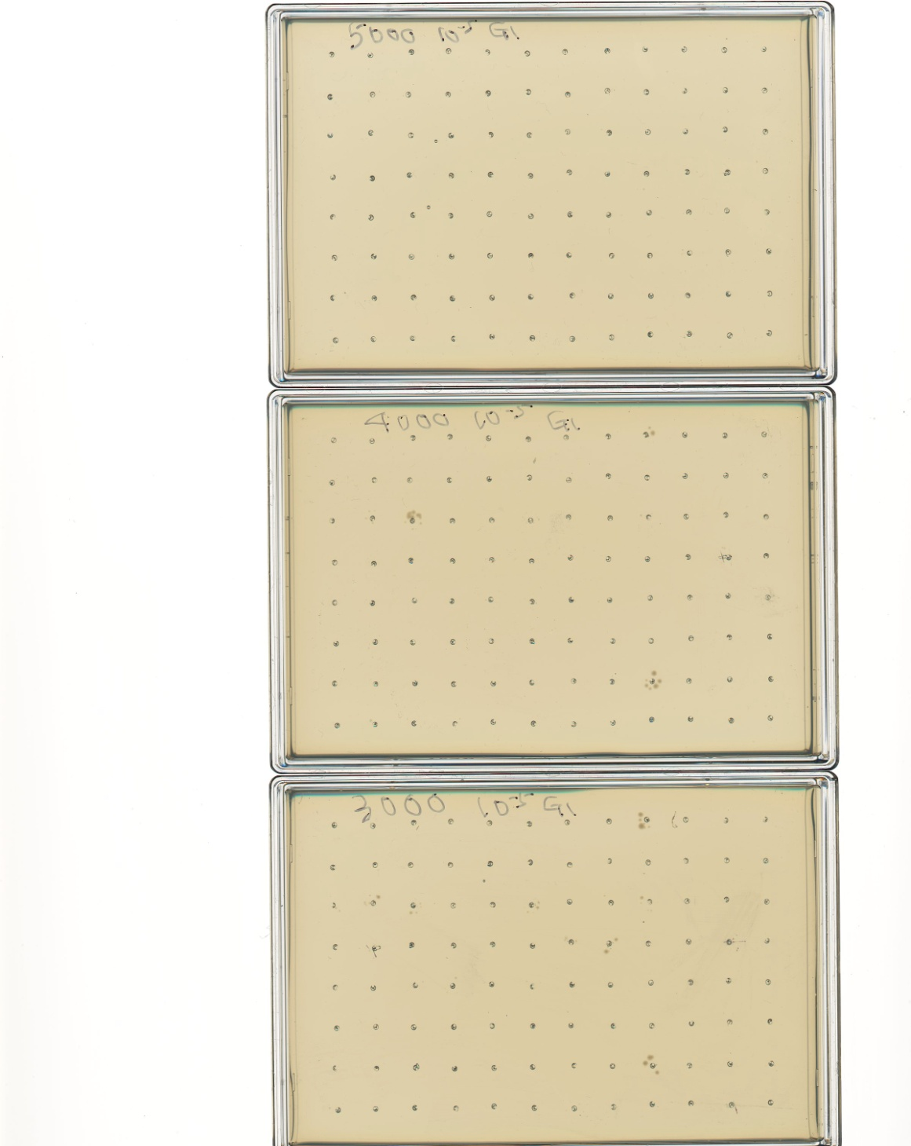
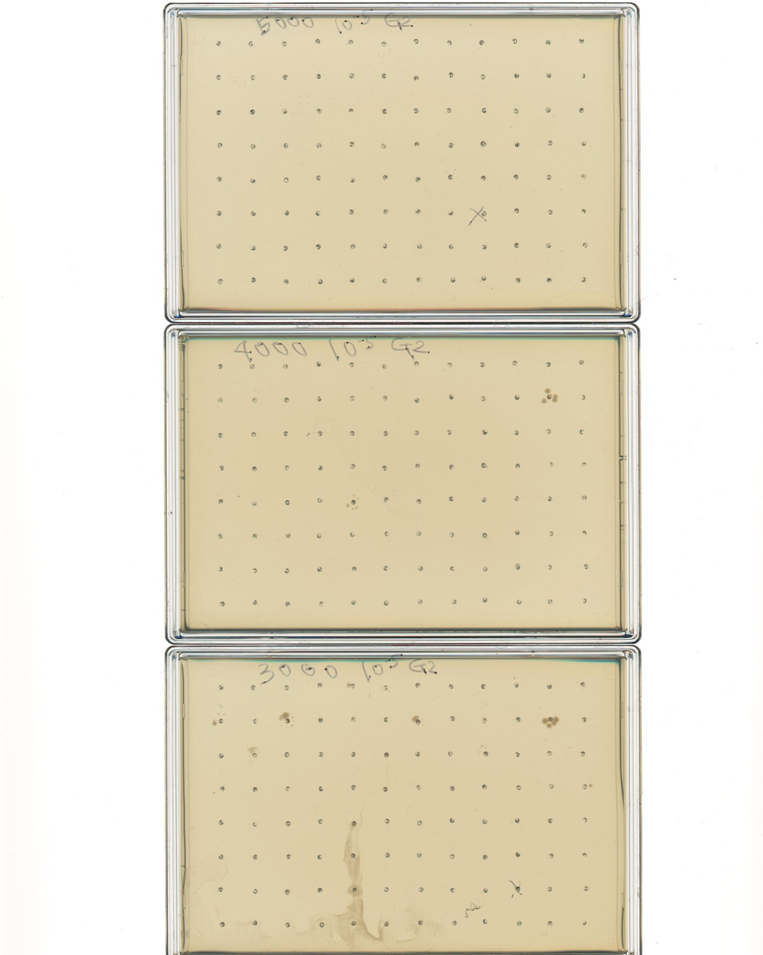
Some remarkable candidates
K130I
K39I
T72A
Q100L
H24Y
M27T
R43L
M28I
M46V
F115I
T35S
L58P
S70C
Q100L
F115L
Q100L
M46V
Q100L
Combination of positive mutations probably will have an additive effect
Present in the screen: Q100L F115L; Q25H Q100L; L32P Q49L A117T; L32Q H96L
Super-Spy mutation
Other mutation
Notes:
Also put the in vitro data here for mutants other than Q100L

Slide 32
Super Spy variants in vitro properties
Spy | MIC_{norm} | Activity (aldolase agg. prev) | Activity (aldolase refold) | Activity (α-LA agg. prev) | k_{on} | k_{off} | KD | Tm | ∆Hm | ∆Cp | ∆G_{NU}(25°C)
variants |  |  |  |  | (×10⁵ mol⁻¹ s⁻¹) | (s⁻¹) | (µM) | (°C) | (kcal mol⁻¹) | (kcal K⁻¹ mol⁻¹) | (kcal mol⁻¹)
WT | 1 | 1 | 1 | 1 | 3.98 | 0.46 | 1.15 | 48.1 | 66.6 | 0.64 | 4.24
 |  |  |  |  | ±0.11 | ±0.011 | ±0.027 | ±0.1 | ±1.5 |  | ±0.10
Q25R | 1.44 | 6.90 | 1.38 | 2.44 | 2.29 | 0.2 | 0.87 | 46.3 | 73.7 | 0.98 | 4.2
 |  | ±0.64 | ±0.31 | ±0.89 | ±0.13 | ±0.005 | ±0.034 | ±0.4 | ±0.8 |  | ±0.10
L32P | 1.92 | 2.52 | 4.85 | 2.1 | 1.51 | 0.03 | 0.2 | 31 | 52.1 | 0.71 | 0.99
 |  | ±0.11 | ±0.57 | ±0.74 | ±0.14 | ±0.002 | ±0.003 | ±0.2 | ±2.5 |  | ±0.02
Q49L | 1.6 | 2.88 | 4.25 | 1.93 | 2.3 | 0.18 | 0.76 | 52 | 59.9 | 0.68 | 4.19
 |  | ±0.14 | ±0.66 | ±0.66 | ±0.06 | ±0.009 | ±0.018 | ±0.2 | ±1.0 |  | ±0.10
H96L | 1.62 | 2.02 | 1.90 | 1.64 | 2.68 | 0.27 | 1 | 50.1 | 56.2 | 0.71 | 3.66
 |  | ±0.32 | ±0.32 | ±0.49 | ±0.14 | ±0.010 | ±0.022 | ±0.1 | ±3.0 |  | ±0.23
Q100L | 2.19 | 1.34 | 4.20 | 2.12 | 1.19 | 0.03 | 0.23 | 53.8 | 28.9 | 0.23 | 2.24
 |  | ±0.04 | ±0.44 | ±0.75 | ±0.13 | ±0.002 | ±0.013 | ±0.6 | ±1.1 |  | ±0.11
F115L | 1.52 | 1.98 | 4.85 | 2.3 | 2.73 | 0.25 | 0.9 | 41.3 | 56.6 | 0.76 | 2.6
 |  | ±0.32 | ±0.56 | ±0.83 | ±0.01 | ±0.007 | ±0.028 | ±0.2 | ±4.9 |  | ±0.22
F115I | 1.65 | 2.21 | 4.33 | 2.34 | 2.82 | 0.33 | 1.17 | 41.7 | 54.3 | 0.98 | 2.43
 |  | ±0.12 | ±0.49 | ±0.85 | ±0.15 | ±0.017 | ±0.097 | ±0.4 | ±1.5 |  | ±0.11

Slide 33
Super-sticky Spy
Induce mutation on Q100
Combine different outstanding mutations
High PenV
Normal tannin resistance
Hydrophobic
Low K_{off}
Super flexible
chaperone activity assay
Trap native substrates using proper cross-linkers in the presence of tannin stress
Capture the co-structure of Spy and its substrate
Notes:
Add a slide to show the kinetic table. Highlight the slowed Krelease parameter.
Add another slice to explain the flowchart of your proposal

Slide 34
Flowchart
Genetic engineering: higher in vivo activity (PenV resistance)
Chaperone assay: higher chaperone activity?
Tannin resistance assay: compare with WT (plasmid→ genomic)
Tm and G_{NU} measurement: stability and flexibility
Super Sticky Spy
Trap native substrate candidates under tannin stress: crosslink, MS
Confirm in WT Spy: gel filtration, Y2H etc.
Co-crystallization and NMR: structure and dynamics
Figure out the significance of Spy by analyzing its substrate functions
Super-sticky Spy
Use known in vitro substrates: Im7AA

Slide 35
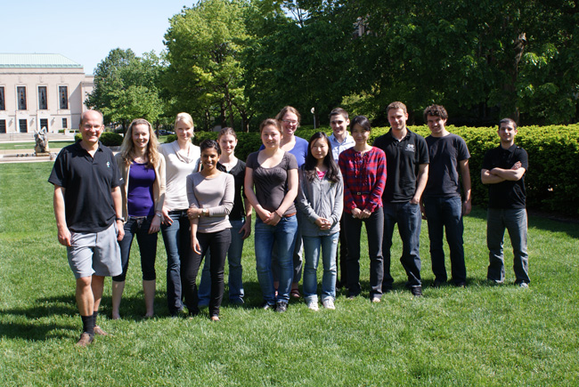
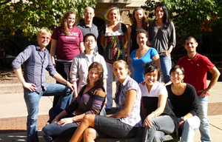
Acknowledgements
Prof. Bardwell and Prof. Jakob
Bardwell lab and Jakob lab

Slide 36
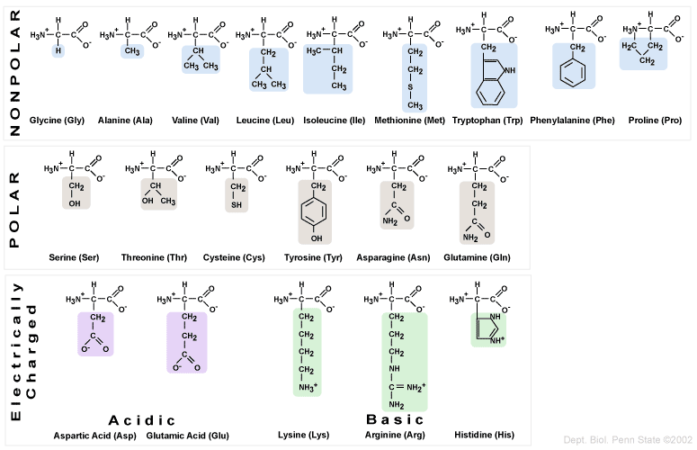
Amino acid substitution of Q100
Notes:
Put the codon onto here
Why Q100L is so dominant
Other hydrophobic residues as candidates

Slide 37
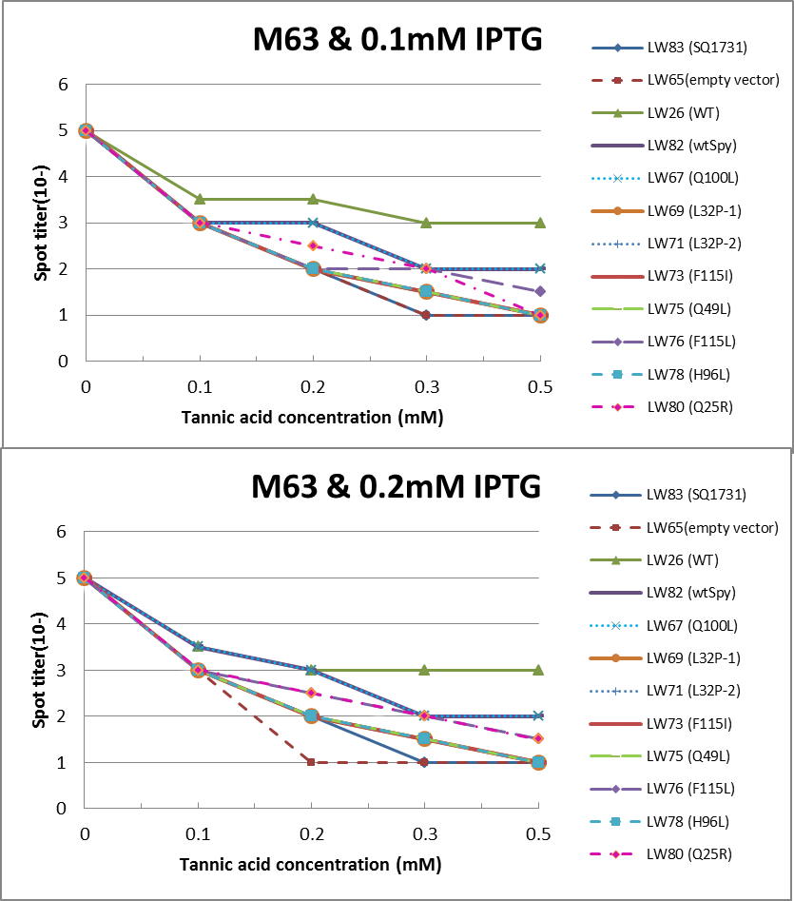
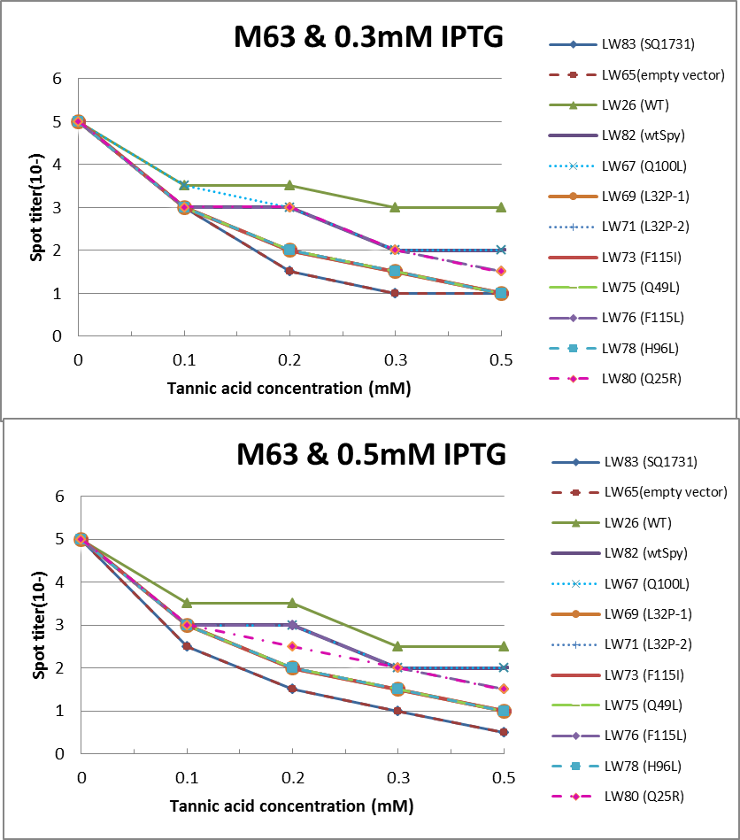
Tannin resistance assay
MOPS and M63 minimal media
Tiny change in tannin resistance for Q100L mutation
Decrease in tannin resistance for other mutations
Notes:
If MOPS is informative enough, it might not be necessary to show M63.

